Slide 1


Department of Information Technology
Project Seminar
Session: 2023-2024
Group Number : C-13
Title of the Project : “Smart Eco-Fertilization Using Python & API”
Presented By : Guide
1. Ujjwal Sadani (C-42) Dr. Sampada S. Wazalwar 2. Utkarsh Gomase (C-43) GHRCE, Nagpur. 3. Varun Rewatkar (C-45) 4. Vedant Dagwar (C-46)

Slide 2
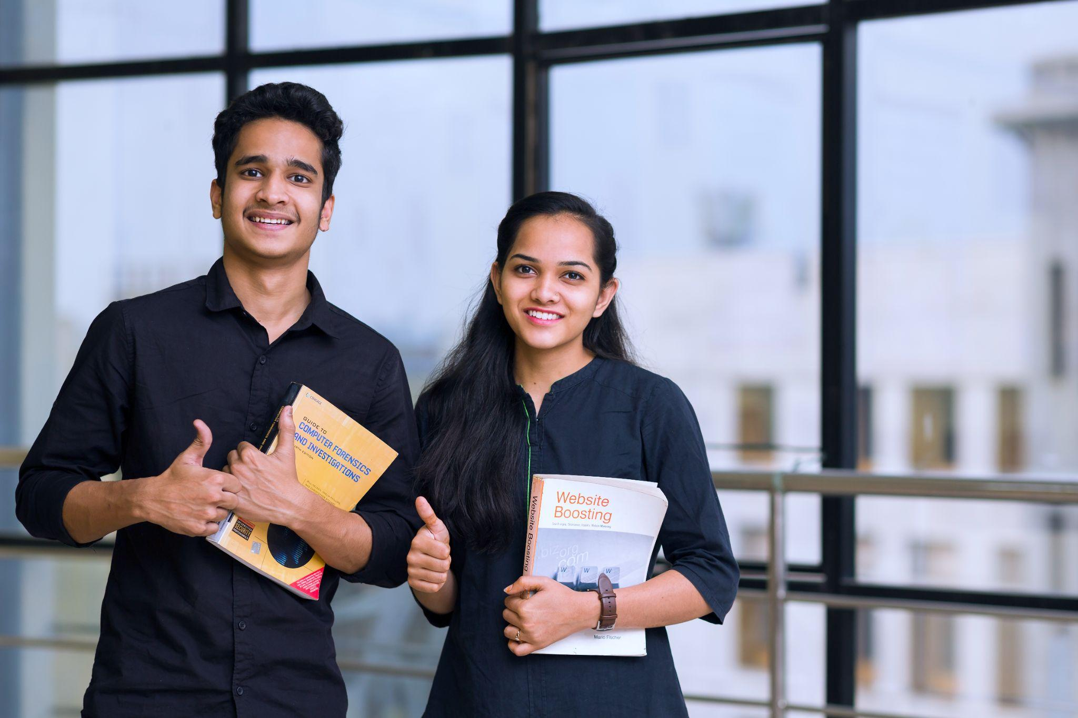
“Smart Eco-Fertilization "
Fertilizer use is typically under the limited control of farmers. For the farmers to achieve higher yields and reduce fertilizer loss, competent guidance is required for the best use of these fertilizers. Additionally, there is a connection between rainfall volume and nutrient loss for various fertilizer applications after each rainfall event. Rainfall that is moderate and falls at the right moment can help nutrients penetrate the soil's rooting zone and dissolve dry fertilizer.

Slide 3

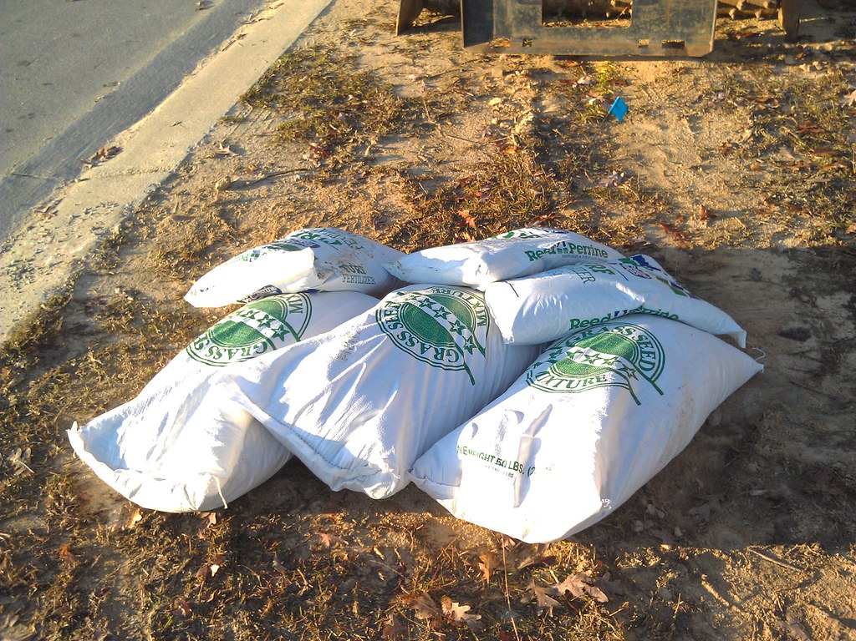
DESCRIPTION OF PROJECT:
OBJECTIVE AND SCOPE
To provide useful information for fertilizer use in terms of
nutrients (NPK) by considering weather forecasts.
OBJECTIVE
To reduce water pollution by slowing down the process
of leaching.
To make the system more budget friendly as using API
rather than IOT makes a great impact
Python, Flask Language, API :
Flask is a micro web framework written in Python for frontend and we use Weather API for backend which we use in eco Fertilization, also we have used machine learning algorithm to predict the N P K concentration.
SCOPE

Slide 4

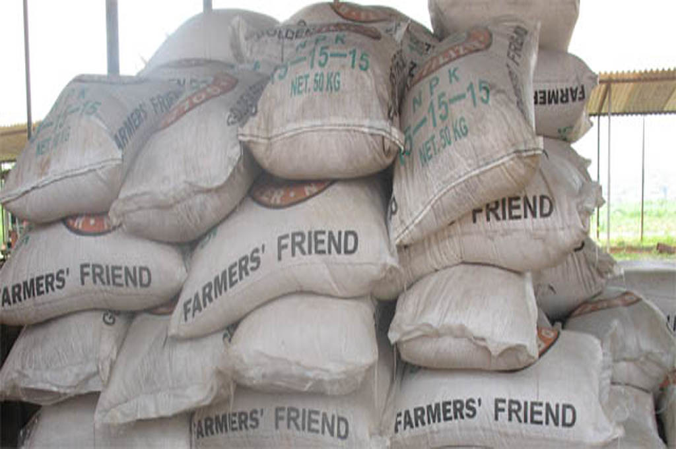

IMPORTANCE OF ECO FERTILIZATION
Agriculture Sector which is playing very important part of national economic growth is agriculture. Agriculture contributes 17-18% to India's GDP and ranks second worldwide in farm outputs. Plants need fertilizers and fertilizers replace the nutrients which crops take from the top layer of the soil.
The absence of fertilizers can cause a drastic reduction in the volume of crop output. But fertilization requires precise action. Rainfall patterns and the amount of nutrients needed for a certain crop must be considered when using fertilizers.
This project uses a machine learning algorithm such as random forest algorithm with k-fold cross-validation technique which takes two inputs from the user that are crop and location. After applying the algorithm, it predicts the amount of nutrients required along with the best time to use fertilizers. The website is built using Flask Python (web framework) to provide access on all platforms and can be shared among users.

Slide 5
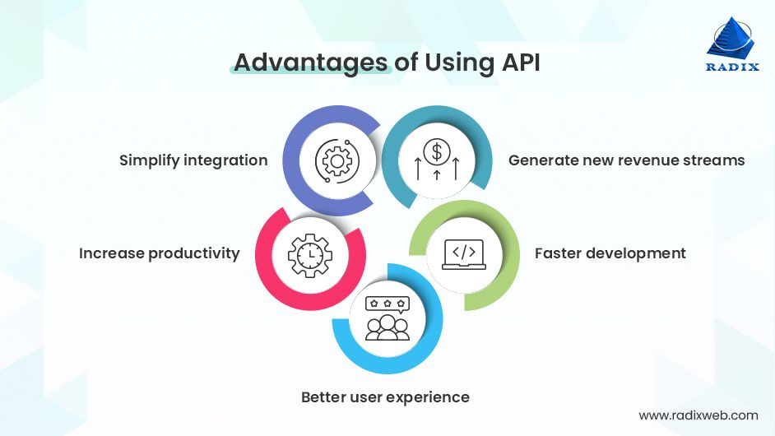

Slide 6
In this study, a predictive model for the nutrients required for crops was obtained using random forest. Random forest regression with the technique called k-fold cross validation represents this model with acceptable accuracy for the prediction is then obtained. A total of seven features have been used to evaluate the algorithm the algorithm requires input from the user (such as location and crop). The location is fed to the Weather API which will return certain characteristics (e.g. temperature, humidity, rainfall, moisture) and if there is a possibility of heavy rainfall, a precautionary message is displayed to the user, otherwise, the proposed algorithm is followed.

Slide 7
start
Block Diagram
User input: crop location
Weather API
Data collection: temp; humidity; rainfall; moisture
REQUEST
RESPONSE
chances of heavy rain
HIGH
Display predictionay message
Predctive modeling
Output N,P,K concentration
end

Slide 8
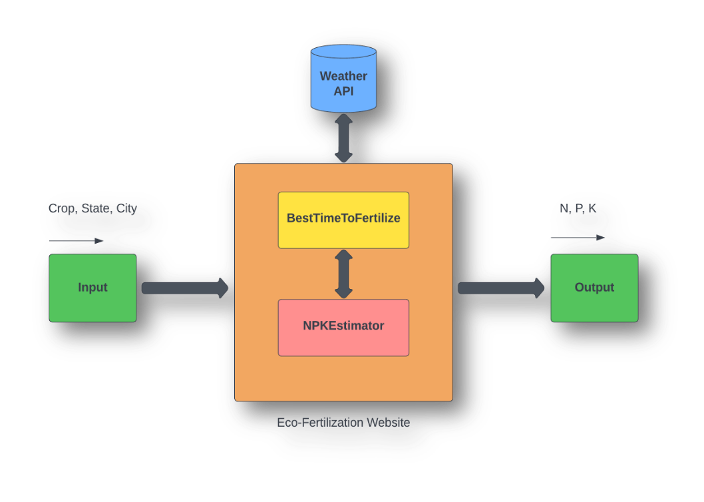
Workplan of the Project
S. no. | Block Name | Functions
1 | Input | User provides data such as crop , state and city using drop down menu
2 | Weather API | Weather details like temperature, rainfall etc is fetched from the weather API
3 | BestTimeToFertilize | This module provides the functionality to determine the best time to fertilize using fetched weather data and provides warming for heavy rain.
4 | NPKEstimator | This module estimates the required ratio of NPK contents in the soil.
5 | Output | Nitrogen, Phosphorus and Potassium content displayed on the website
System architecture is a conceptual model that defines the structure and behavior of the system. It comprises of the system components and the relationships describing how they work together to implement the overall system. The Figure shows the system’s architecture and the various components added to them.
The description of each component from the block diagram and their major functionalities with respect to the Eco-Fertilization as a complete unit is described in the table.

Slide 9
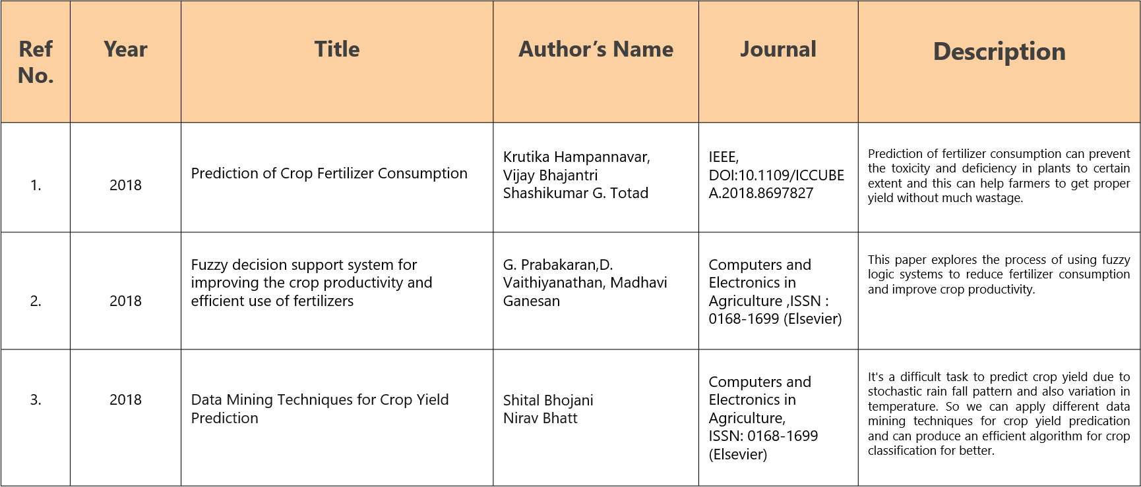
Literature Review

Slide 10
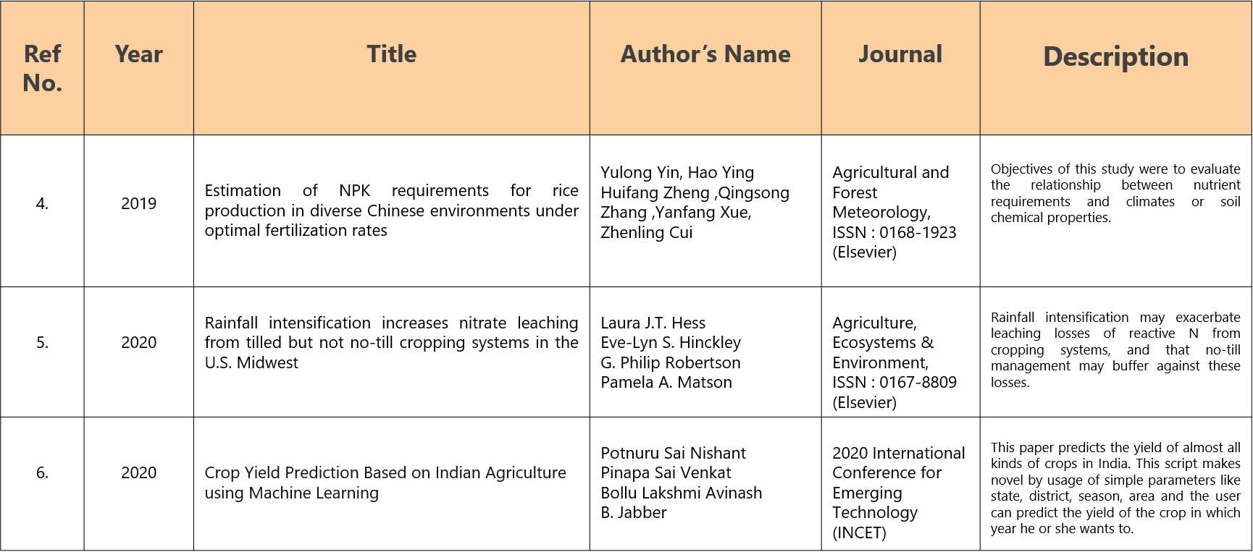

Slide 11
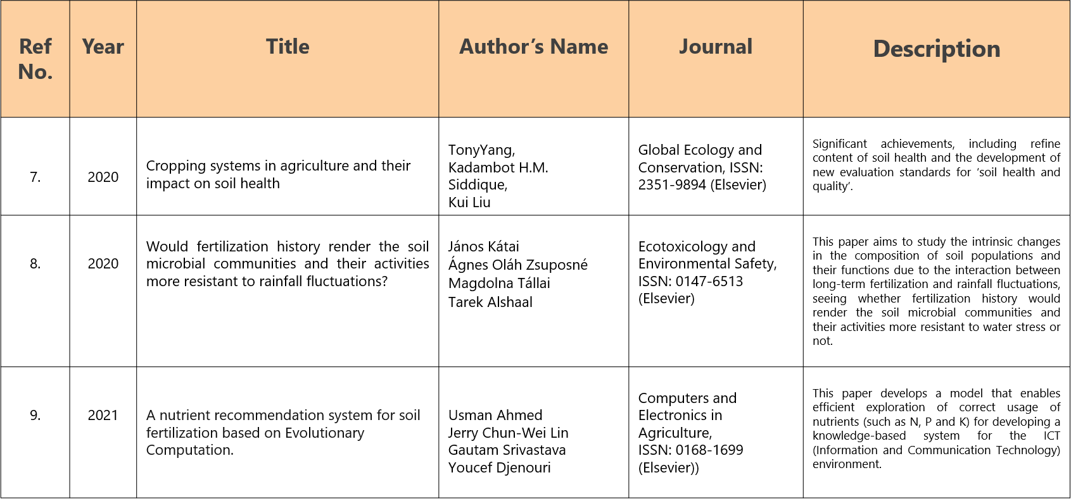

Slide 12
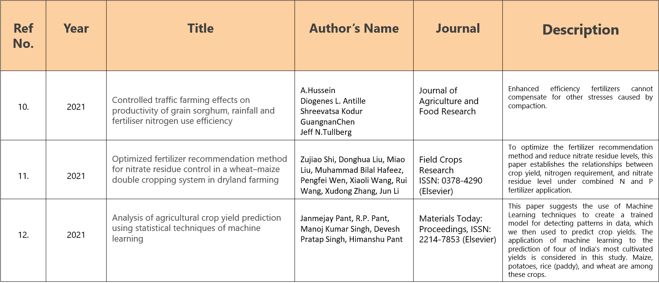

Slide 13
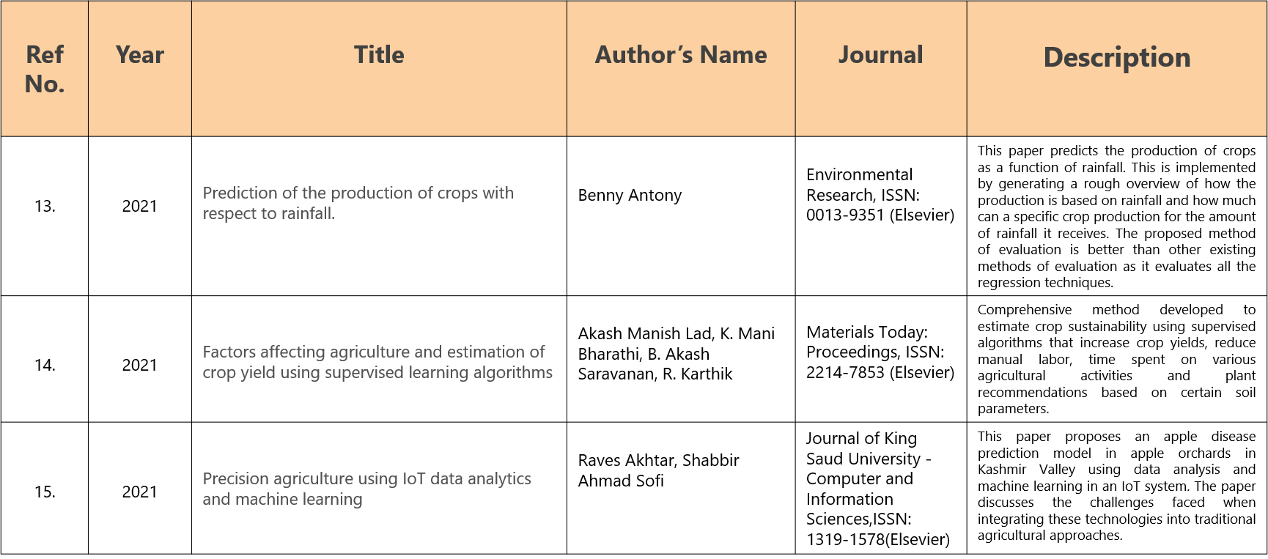

Slide 14
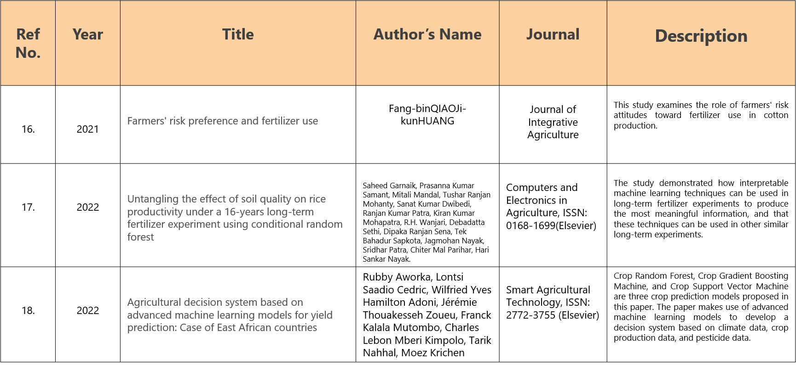

Slide 15
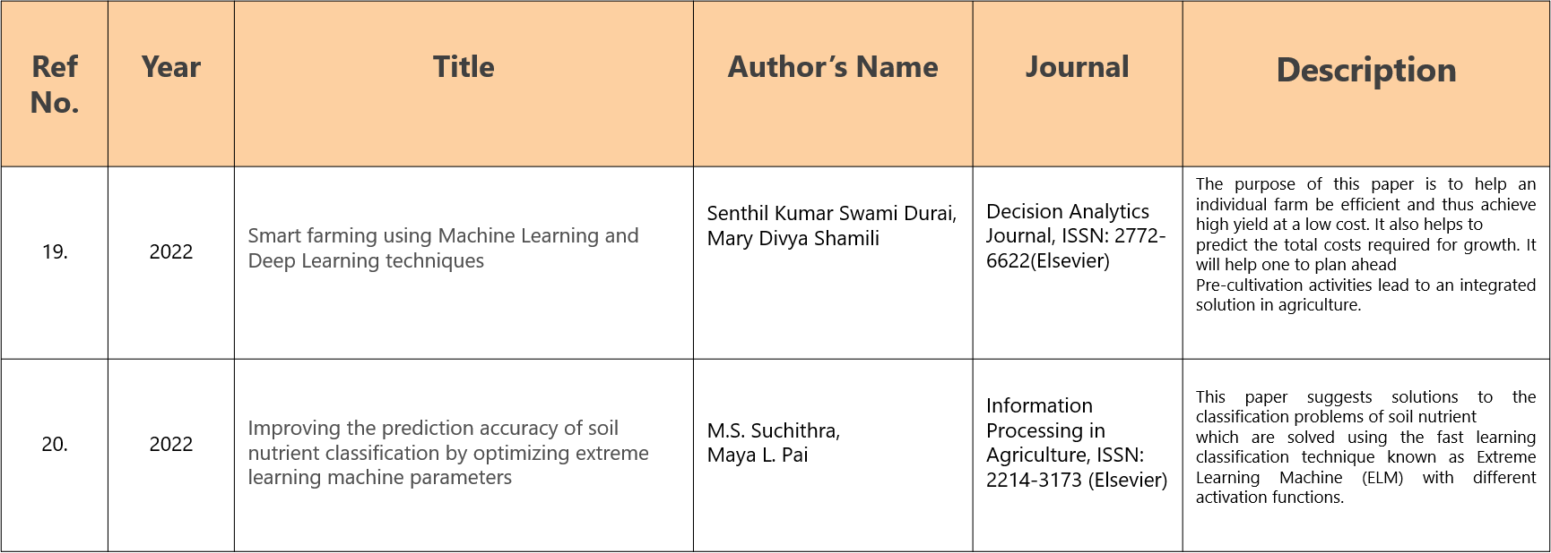

Slide 16
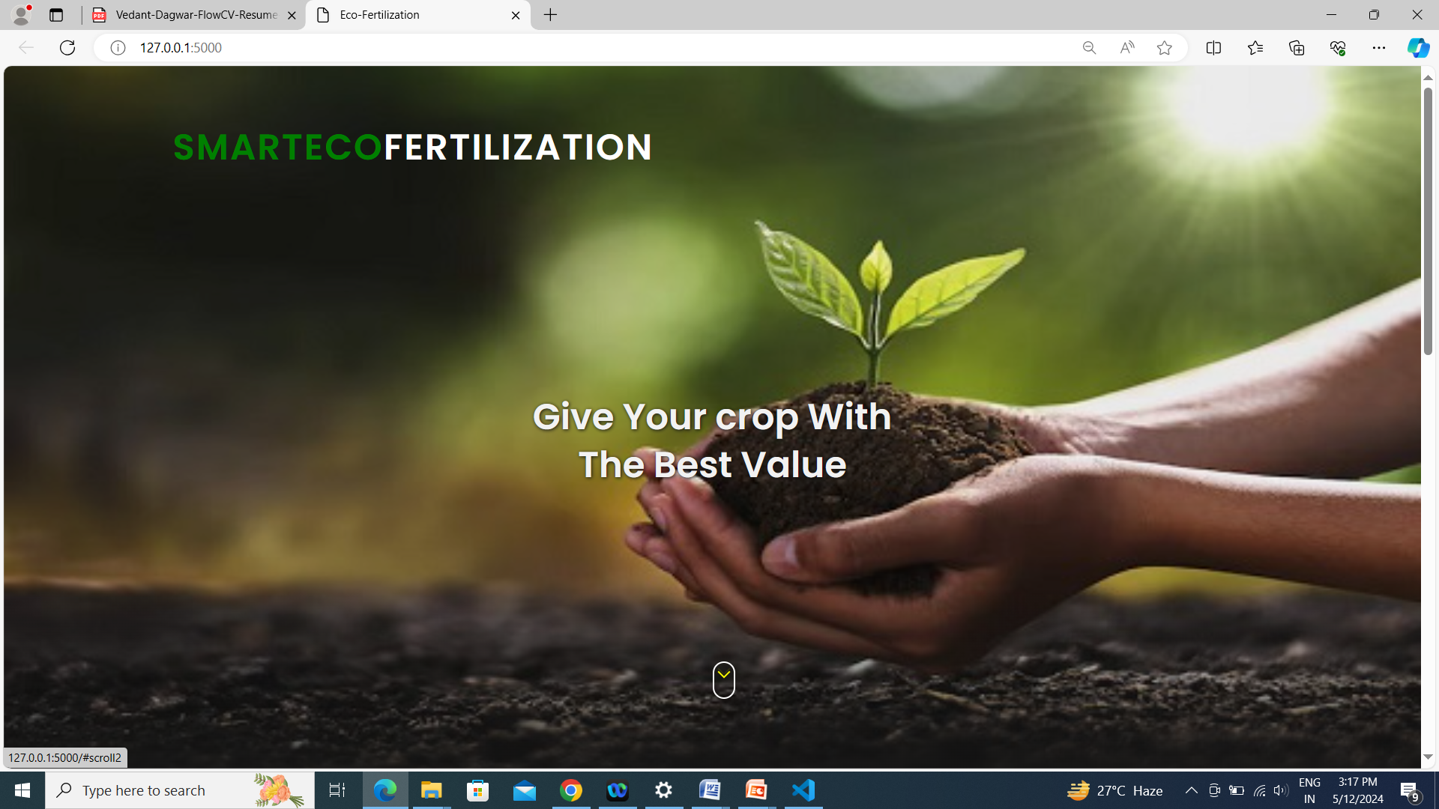
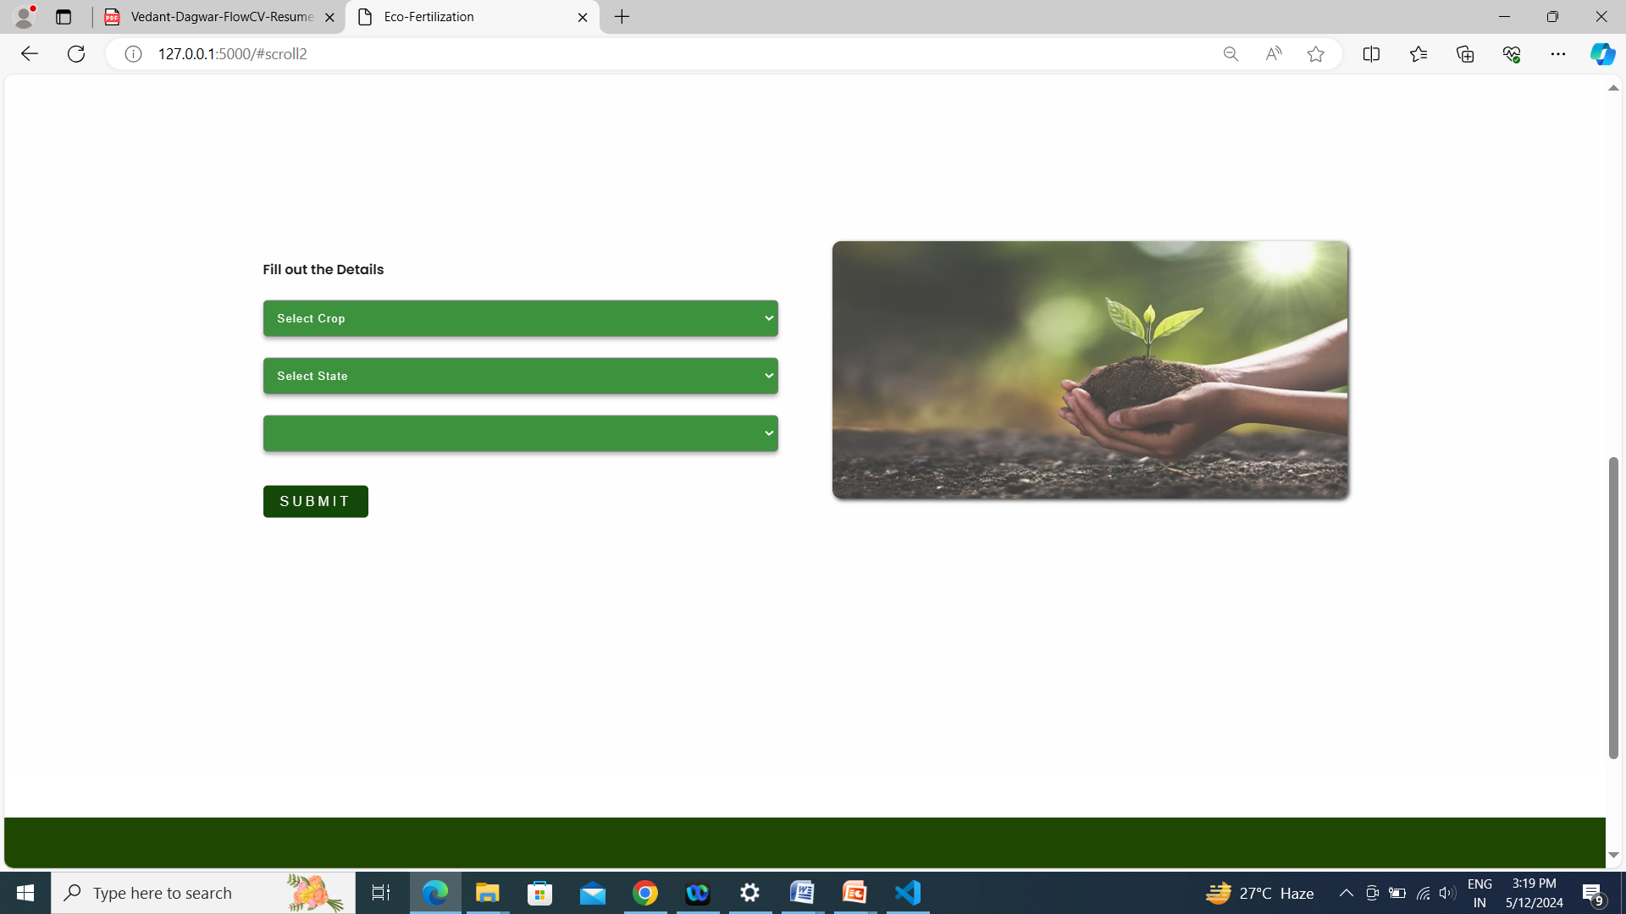
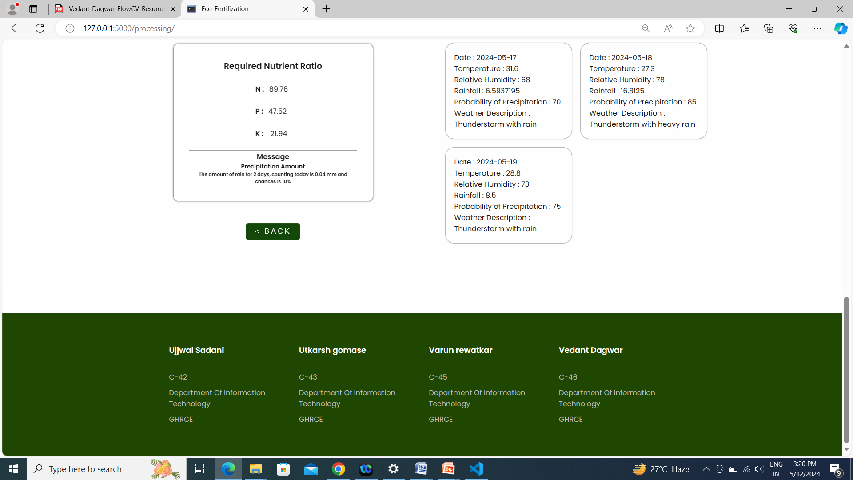
output

Slide 17
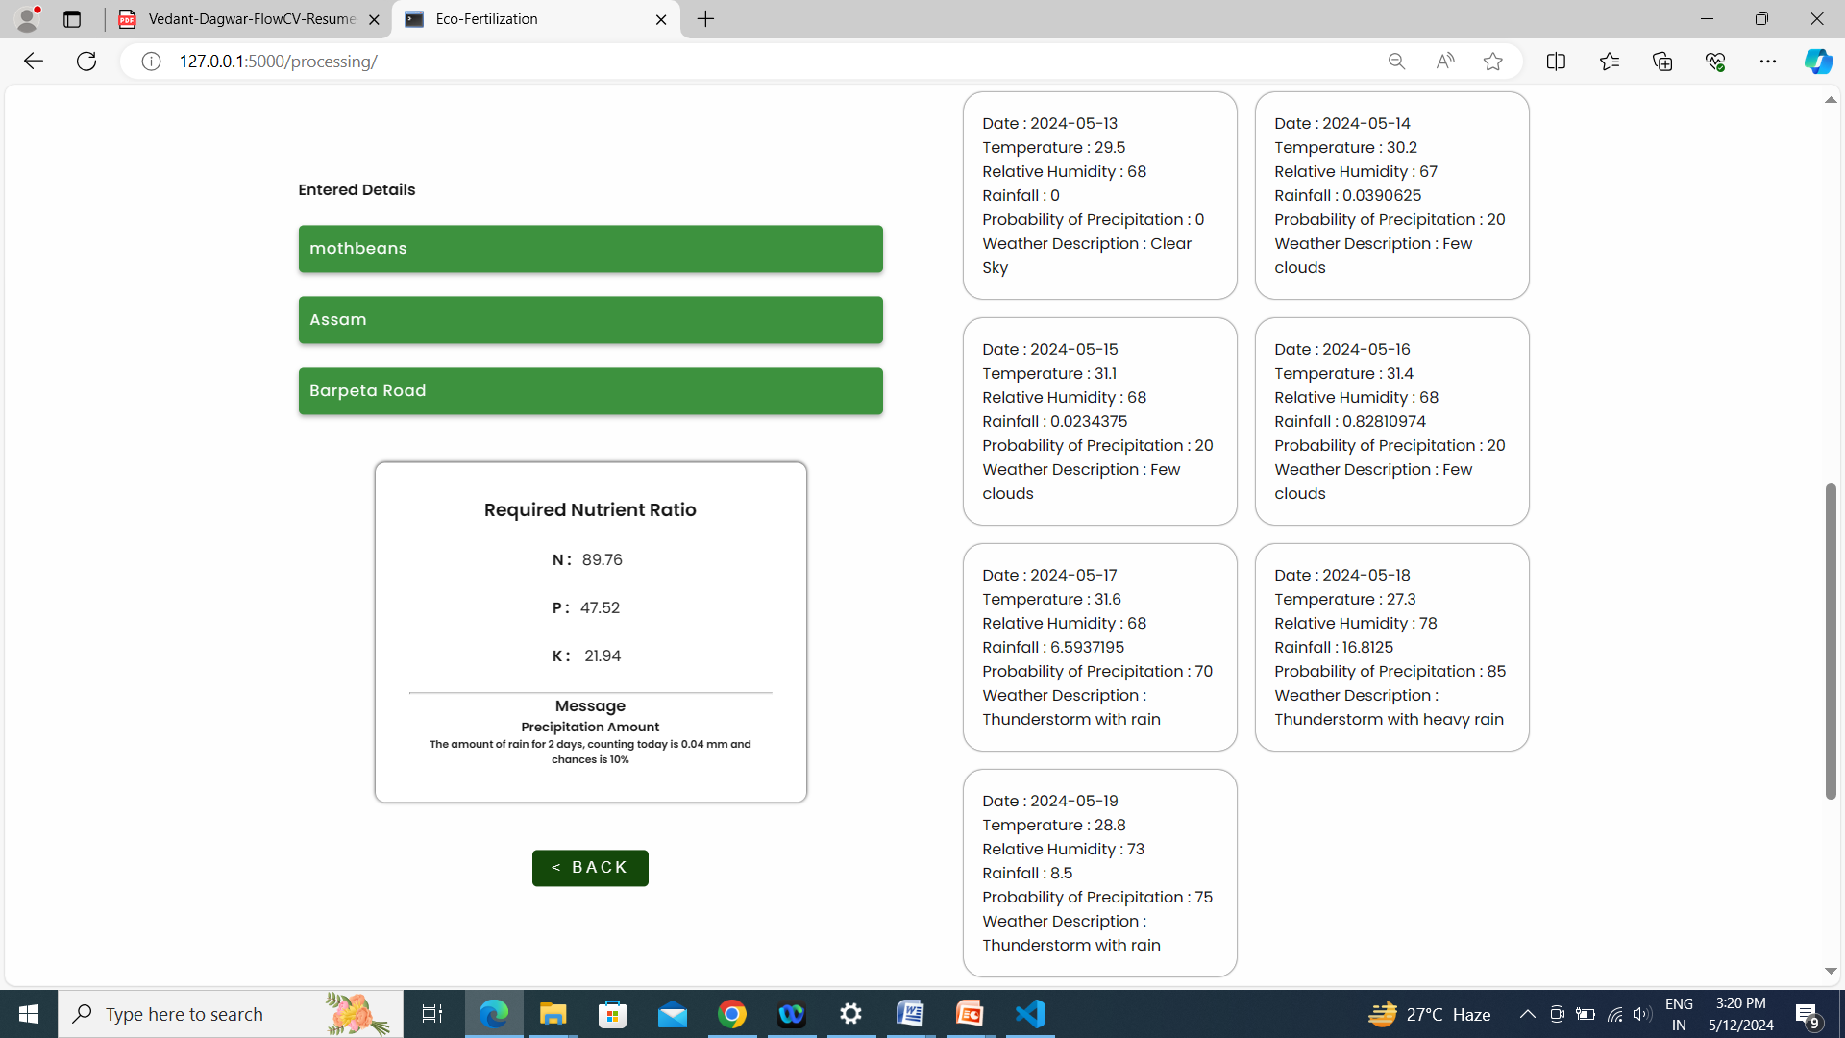

Slide 18
REFERENCES
[1] Krutika Hampannavar,Vijay Bhajantri,Shashikumar G. Totad , “Prediction of Crop Fertilizer Consumption,” Fourth International Conference on Computing Communication Control and Automation (ICCUBEA), 2018, PP. 1-5
[2] G. Prabakaran,D. Vaithiyanathan, Madhavi Ganesan , “Fuzzy decision support system for improving the crop productivity and efficient use of fertilizers ,” Computers and Electronics in Agriculture, vol-150, 2018, PP. 88-97
[3] Shital Bhojani,Nirav Bhatt, “Data Mining Techniques for Crop Yield Prediction,” Computers and Electronics in Agriculture, vol-6, 2018, PP. 357-358
[4] Yulong Yin, Hao Ying,Huifang Zheng ,Qingsong Zhang ,Yanfang Xue,Zhenling Cui , “Estimation of NPK requirements for rice production in diverse Chinese environments under optimal fertilization rates ,” Agricultural and Forest Meteorology, vol-279, 2019, PP. 1-6
[5] Laura J.T. Hess,Eve-Lyn S. Hinckley,G. Philip Robertson,Pamela A. Matson , “Rainfall intensification increases nitrate leaching from tilled but not no-till cropping systems in the U.S. Midwest ,” Agriculture, Ecosystems & Environment, vol-290, 2020, PP. 1-10

Slide 19
6] Potnuru Sai Nishant,Pinapa Sai Venkat,Bollu Lakshmi Avinash,B. Jabber , “Crop Yield Prediction Based on Indian Agriculture using Machine Learning,” 2020 International Conference for Emerging Technology (INCET), 2020, PP. 1-4
[7] Tony Yang,Kadambot H.M. ,Siddique,Kui Liu , “Cropping systems in agriculture and their impact on soil health ,” Global Ecology and Conservation, vol-23, year, PP. 1-13
[8] János Kátai,Ágnes Oláh Zsuposné,Magdolna Tállai,Tarek Alshaal, “Would fertilization history render the soil microbial communities and their activities more resistant to rainfall fluctuations? ,” Ecotoxicology and Environmental Safety, vol-201, 2020, PP. 1-11
[9] Usman Ahmed,Jerry Chun-Wei Lin, Gautam Srivastava,Youcef Djenouri , “A nutrient recommendation system for soil fertilization based on Evolutionary Computation,” Computers and Electronics in Agriculture, vol-189, 2021, PP. 1-7
[10] A.Hussein , Diogenes L. Antille , Shreevatsa Kodur , GuangnanChen,Jeff N.Tullberg , “Controlled traffic farming effects on productivity of grain sorghum, rainfall and fertiliser nitrogen use efficiency,” Journal of Agriculture and Food Research, vol-3, 2021, PP. 1-17

Slide 20
[11] Zujiao Shi, Donghua Liu, Miao Liu, Muhammad Bilal Hafeez, Pengfei Wen, Xiaoli Wang, Rui Wang, Xudong Zhang, Jun Li , “Optimized fertilizer recommendation method for nitrate residue control in a wheat–maize double cropping system in dryland farming ,” Field Crops Research , vol-271, 2021, PP. 1-10
[12] Janmejay Pant, R.P. Pant, Manoj Kumar Singh, Devesh Pratap Singh, Himanshu Pant , “Analysis of agricultural crop yield prediction using statistical techniques of machine learning ,” Materials Today: Proceedings, vol-46, 2021, PP. 1-10
[13] Benny Antony , “Prediction of the production of crops with respect to rainfall.,” Environmental Research, vol-202, 2021, PP. 1-5
[14] Akash Manish Lad, K. Mani Bharathi, B. Akash Saravanan, R. Karthik, “Factors affecting agriculture and estimation of crop yield using supervised learning algorithms ,” Materials Today: Proceedings,, 2022, PP. 1-10
[15] Raves Akhtar, Shabbir Ahmad Sofi, “Precision agriculture using IoT data analytics and machine learning,” Journal of King Saud University - Computer and Information Sciences, 2021, PP. 1-17

Slide 21
[16] Fang-binQIAOJi-kunHUANG, “Farmers' risk preference and fertilizer use,” Journal of Integrative Agriculture,vol-20, PP. 1987-1995
[17] Saheed Garnaik, Prasanna Kumar Samant, Mitali Mandal, Tushar Ranjan Mohanty, Sanat Kumar Dwibedi, Ranjan Kumar Patra, Kiran Kumar Mohapatra, R.H. Wanjari, Debadatta Sethi, Dipaka Ranjan Sena, Tek Bahadur Sapkota, Jagmohan Nayak, Sridhar Patra, Chiter Mal Parihar, Hari Sankar Nayak, “Untangling the effect of soil quality on rice productivity under a 16-years long-term fertilizer experiment using conditional random forest,” Computers and Electronics in Agriculture, vol-197,2022, PP. 1-10
[18] Rubby Aworka, Lontsi Saadio Cedric, Wilfried Yves Hamilton Adoni, Jérémie Thouakesseh Zoueu, Franck Kalala Mutombo, Charles Lebon Mberi Kimpolo, Tarik Nahhal, Moez Krichen, “Agricultural decision system based on advanced machine learning models for yield prediction: Case of East African countries,” Smart Agricultural Technology, vol-3, 2022, PP. 1-9
[19] Senthil Kumar Swami Durai, Mary Divya Shamili, “Smart farming using Machine Learning and Deep Learning techniques,” Decision Analytics Journal, vol-2, 2022, PP. 1-30
[20] M.S. Suchithra, Maya L. Pai, “Improving the prediction accuracy of soil nutrient classification by optimizing extreme learning machine parameters,” Information Processing in Agriculture, vol-7, 2022, PP. 1-11

Slide 22
[19] Khan, Atiya; Vibhute, Amol D.; Mali, Shankar; Patil, C. H.,” A systematic review on hyperspectral imaging technology with a machine and deep learning methodology for agricultural applications” ECOLOGICAL INFORMATICS, JUL 2022
[20] Khaire, Utkarsh Mahadeo; Dhanalakshmi, R.,” Stability Investigation of Improved Whale Optimization Algorithm in the Process of Feature Selection”, IETE TECHNICAL REVIEW, MAR 4 2022
[21] Raut, Ekta R.; Bedmohata (Thakur), Monita A.; Chaudhari, Archana R.” Comparative study of preparation and characterization of activated carbon obtained from sugarcane bagasse and rice husk by using H3PO4 and ZnCl2”, MATERIALS TODAY-PROCEEDINGS,2022
[22] Golait, Manohar; Yadav, Manish Varun; Patil, Balasaheb H.; Baudha, Sudeep; Bramhane, Lokesh Kumar,” Golait, Manohar; Yadav, Manish Varun; Patil, Balasaheb H.; Baudha, Sudeep; Bramhane, Lokesh Kumar”, INTERNATIONAL JOURNAL OF MICROWAVE AND WIRELESS TECHNOLOGIES, OCT 2022
[23] Bramhane, Lokesh; Salankar, Suresh; Gaikwad, Mahendra; Panchore, Meena,” Impact of Work Function Engineering in Charge Plasma Based Bipolar Devices”, SILICON,JUN 2022
[24] Kumar, Rakesh; Panchore, Meena; Bramhane, Lokesh; Singh, Jawar” Comparative Performance and Reliability Analysis of Doping and Junction Free Devices with High-kappa/Vacuum Gate Dielectric”, SILICON,JUN2022
[25]Adjei, Seth A.; Baker, Ryan S.; Bahel, Vedant,” Seven-Year Longitudinal Implications of Wheel Spinning and Productive Persistence”, ARTIFICIAL INTELLIGENCE IN EDUCATION (AIED 2021), PT I,2021
[26] Iwendi, Celestine; Bashir, Ali Kashif; Peshkar, Atharva; Sujatha, R.; Chatterjee, Jyotir Moy; Pasupuleti, Swetha; Mishra, Rishita; Pillai, Sofia; Jo, Ohyun,” COVID-19 Patient Health Prediction Using Boosted Random Forest Algorithm”, FRONTIERS IN PUBLIC HEALTH, JUL 3 2020
[27] Khekare, Ganesh; Verma, Shrutika; Sur, Samay; Haldkar, Rakesh; Moon, Pratik” Design of Fruit Segregation and Packaging Machine”, 2020 INTERNATIONAL CONFERENCE ON COMPUTATIONAL PERFORMANCE EVALUATION (COMPE-2020),2020
[28] Dhule, Chetan; Shrawankar, Urmila,” POF-SVLM: pareto optimized framework for seamless VM live migration”, COMPUTING,OCT2020
[29] Kumar, K.; Farande, K. U.; Ajai, S.; Sahu, T. K.; Raut, A.; Farande, S.; Tichkule, Y,” Kumar, K.; Farande, K. U.; Ajai, S.; Sahu, T. K.; Raut, A.; Farande, S.; Tichkule, Y”, TRENDS IN MANUFACTURING PROCESSES, ICFTMM 2018,2020
[30] Kumari, Parveen; Singh, Sugandha; Aggarwal, Gaurav,” Kumari, Parveen; Singh, Sugandha; Aggarwal, Gaurav”, INTELLIGENT COMMUNICATION TECHNOLOGIES AND VIRTUAL MOBILE NETWORKS, ICICV 2019,2020
[31] Yerne, Shubhangi; Shrawankar, Urmila,” Analysis of Geographical Change Detection using Satellite Images”, 2020 IEEE 9TH INTERNATIONAL CONFERENCE ON COMMUNICATION SYSTEMS AND NETWORK TECHNOLOGIES (CSNT 2020),2020
[32] Dutta, Prateek; Sarkar, Abhiroop; Ambekar, Yash; Pek, Hui Ting; Juwono, F. H.; Sakarkar, Gopal,” A Computational Approach for Predicting the Termination of COVID-19”, 2022 INTERNATIONAL CONFERENCE ON GREEN ENERGY, COMPUTING AND SUSTAINABLE TECHNOLOGY (GECOST)2022

Slide 23
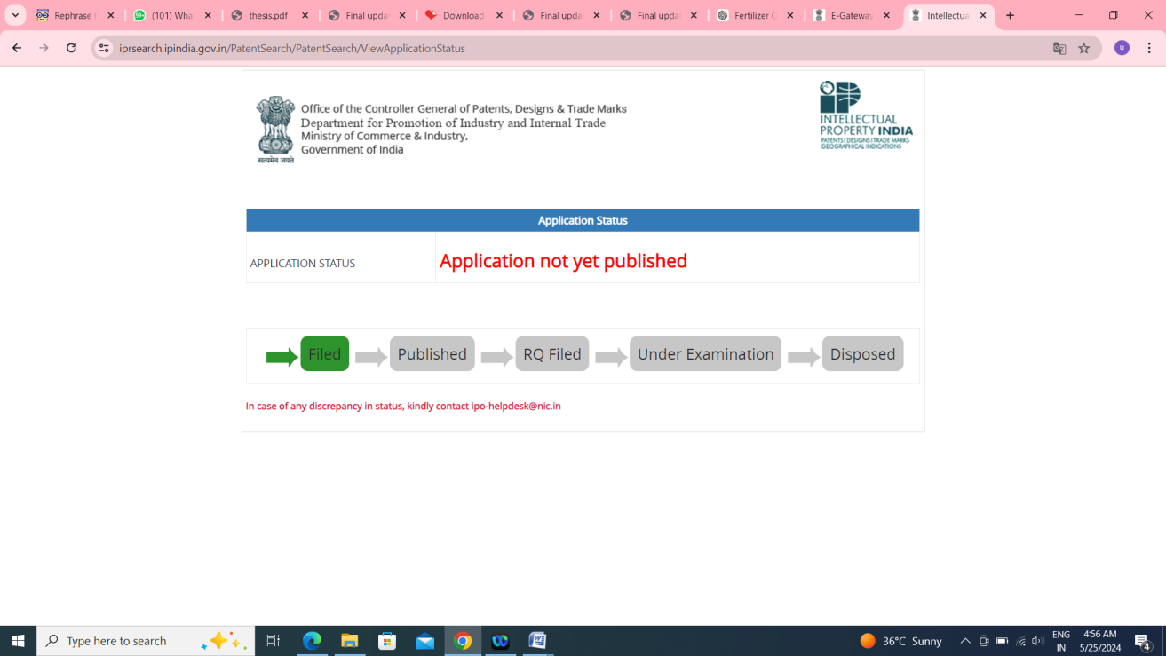
PATENT APPLICATION FILLED AND DONE WITH FILING
Ujjwal Sadani, Utkarsh Gomase, Vedant Dagwar, Varun Rewatkar, Sampada Wazalwar
AN ECO-FERTILIZATION SYSTEM
Application No. 202421020445
Date of Filing: 19/3/2024
Status:Filed

Slide 24

Thank You!

